Slide 1
8/30/20 - plots
Difference (F2000 – F2000_Contrail) plots
ordered by variable and level
level ranges from 14 to 20
13 to 19 in figures because of array zero-indexing
color scales between figures are different!
will make consistent for next set of plots

Slide 2
Acronyms and units (from NetCDF files)
Acronym | Measurement | Units
AREI | Average ice effective radius | micron
CLDICE | Grid box averaged cloud ice amount | kg/kg
FREQI | Fractional occurrence of ice | N/A (fraction)
ICIMR | Prognostic in-cloud ice mixing ratio | kg/kg
IWC | Grid box average ice water content | kg/m³
QRL | Longwave heating rate | K/s
*Can replace acronyms in future plots with full names if desired.

Slide 3
Levels and pressures
Level | Pressure (hPa) | Level | Pressure (hPa)
0 | 3.64346569404006 | 16 | 273.9108167588711
1 | 7.594819646328688 | 17 | 322.2419023513794
2 | 14.356632251292467 | 18 | 379.10090386867523
3 | 24.612220004200935 | 19 | 445.992574095726
4 | 35.92325001955032 | 20 | 524.6871747076511
5 | 43.1937500834465 | 21 | 609.7786948084831
6 | 51.67749896645546 | 22 | 691.3894303143024
7 | 61.52049824595451 | 23 | 763.404481112957
8 | 73.75095784664154 | 24 | 820.8583686500788
9 | 87.82123029232025 | 25 | 859.5347665250301
10 | 103.31712663173676 | 26 | 887.0202489197254
11 | 121.54724076390266 | 27 | 912.644546944648
12 | 142.99403876066208 | 28 | 936.1983984708786
13 | 168.22507977485657 | 29 | 957.485479535535
14 | 197.9080867022276 | 30 | 976.325407391414
15 | 232.82861895859241 | 31 | 992.556095123291

Slide 4
AREI

Slide 5
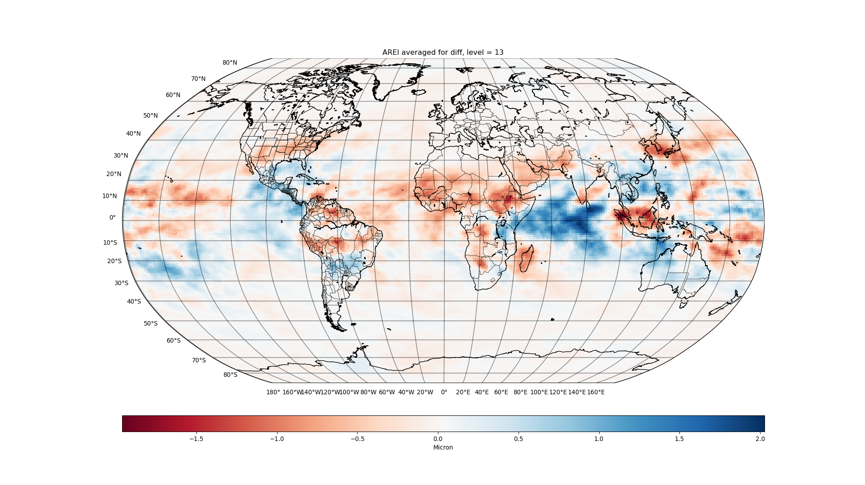

Slide 6
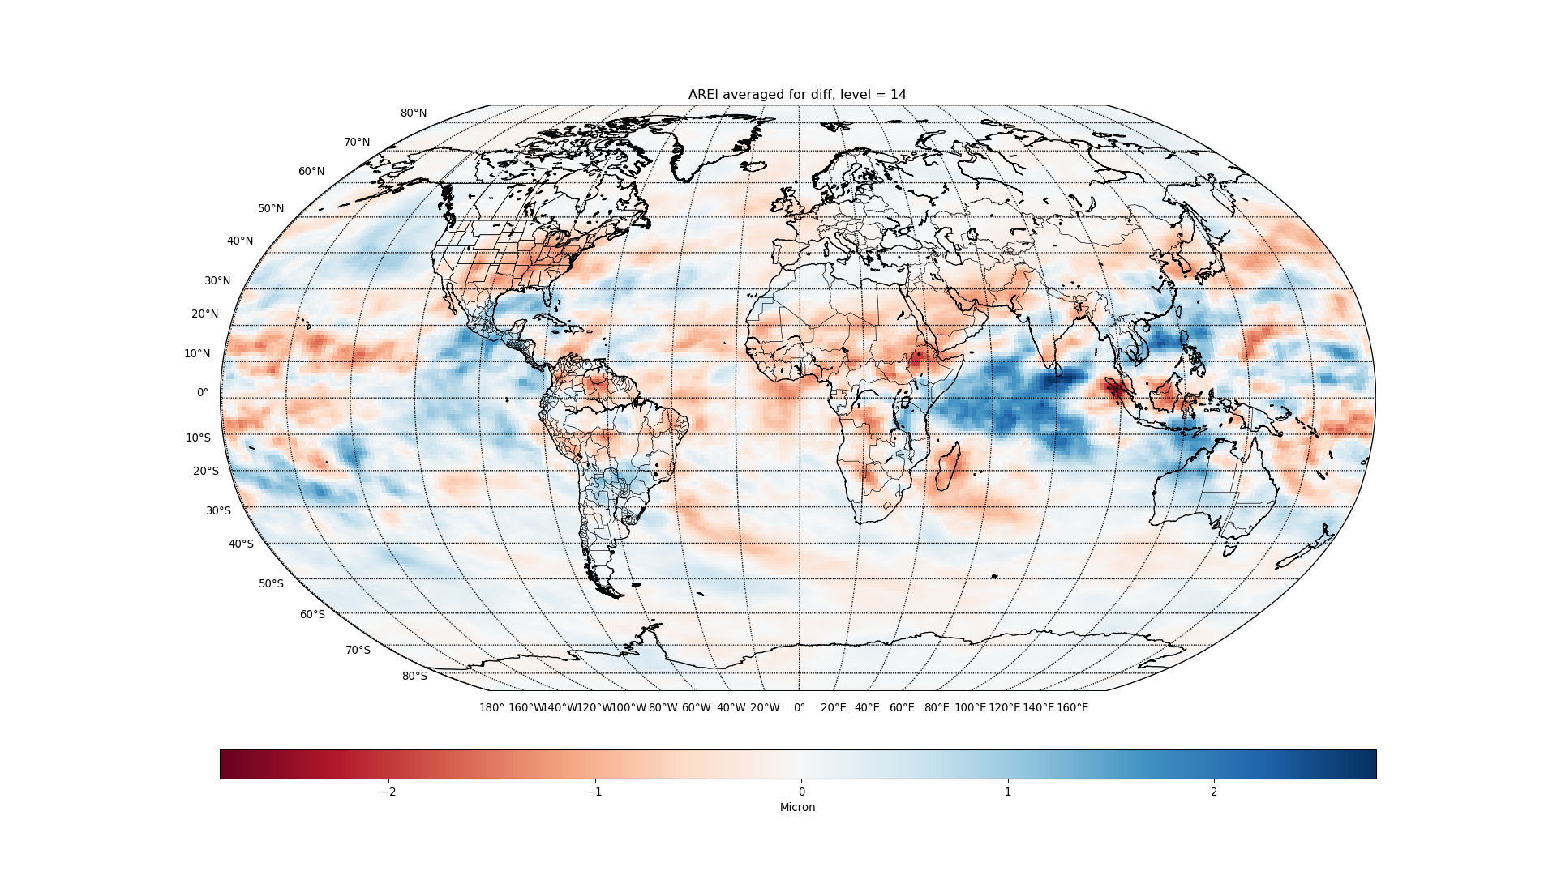

Slide 7
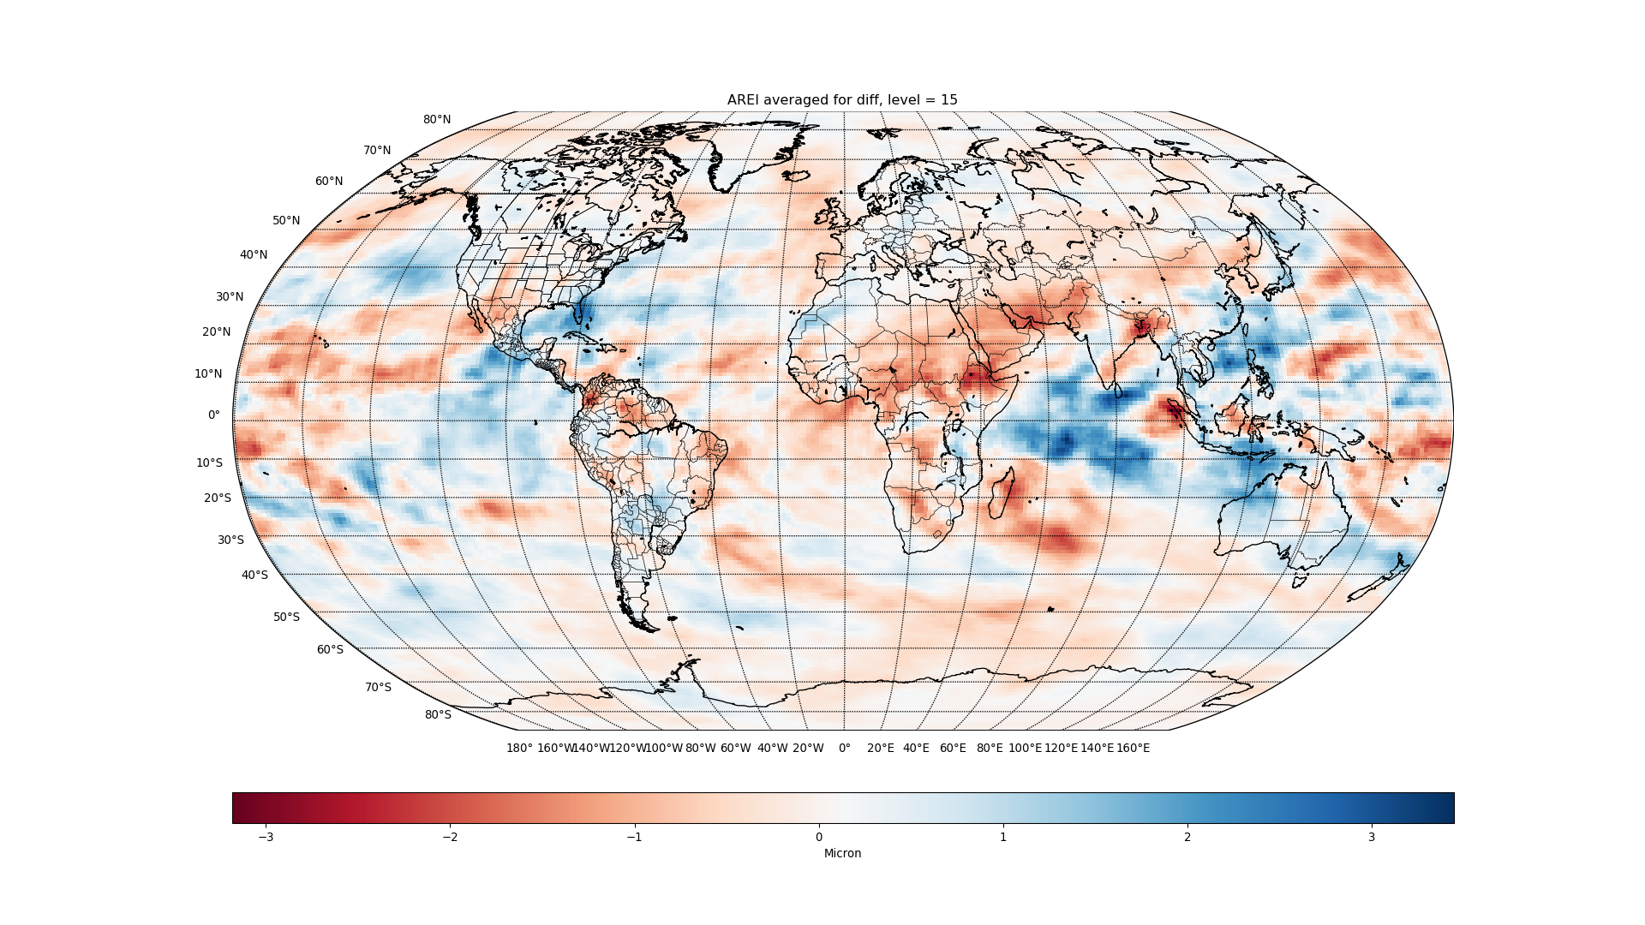

Slide 8
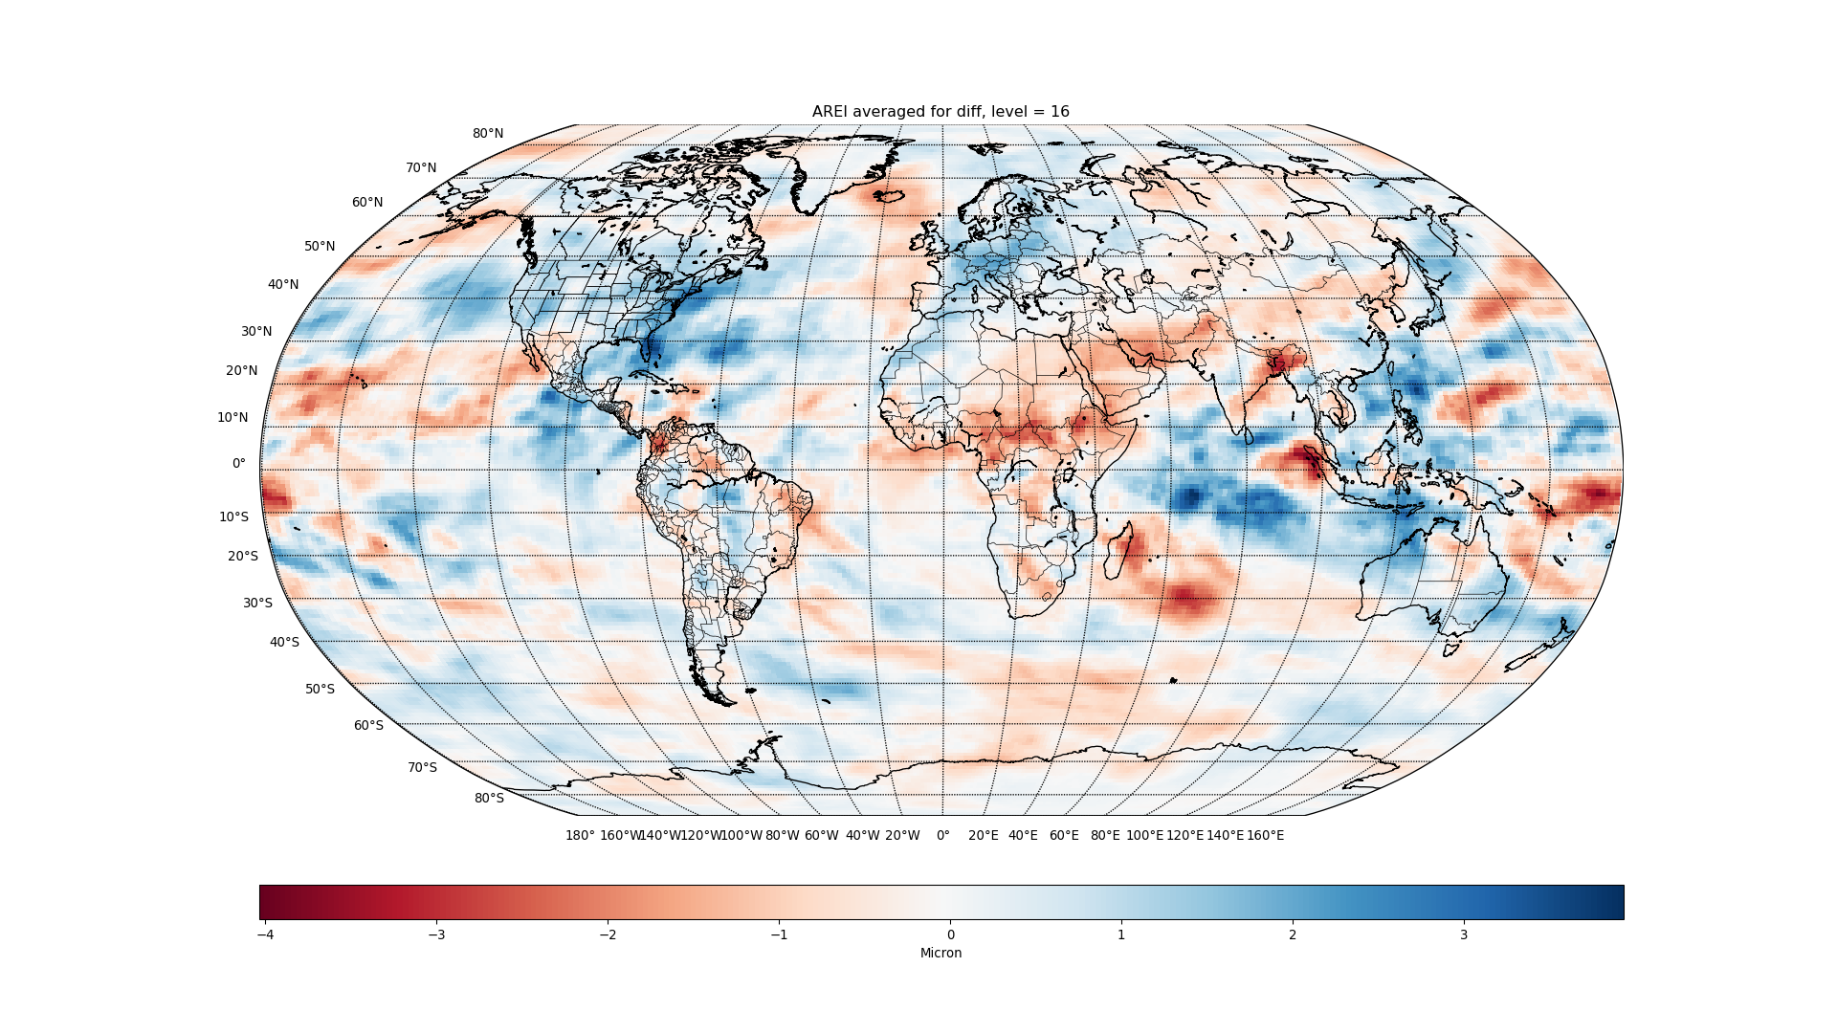

Slide 9
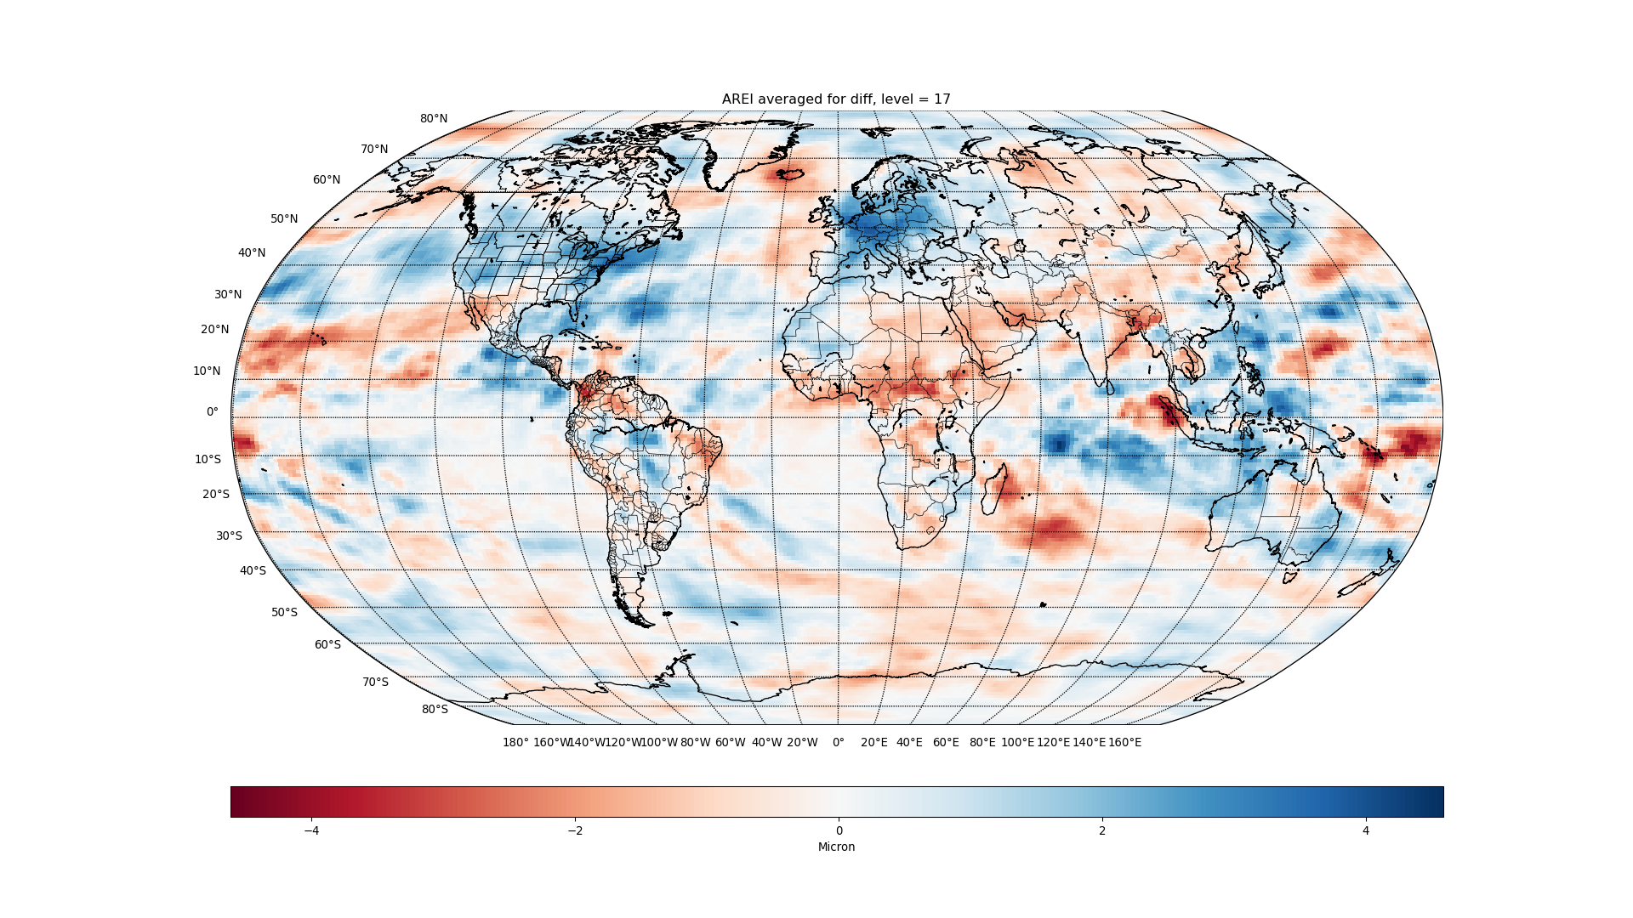

Slide 10
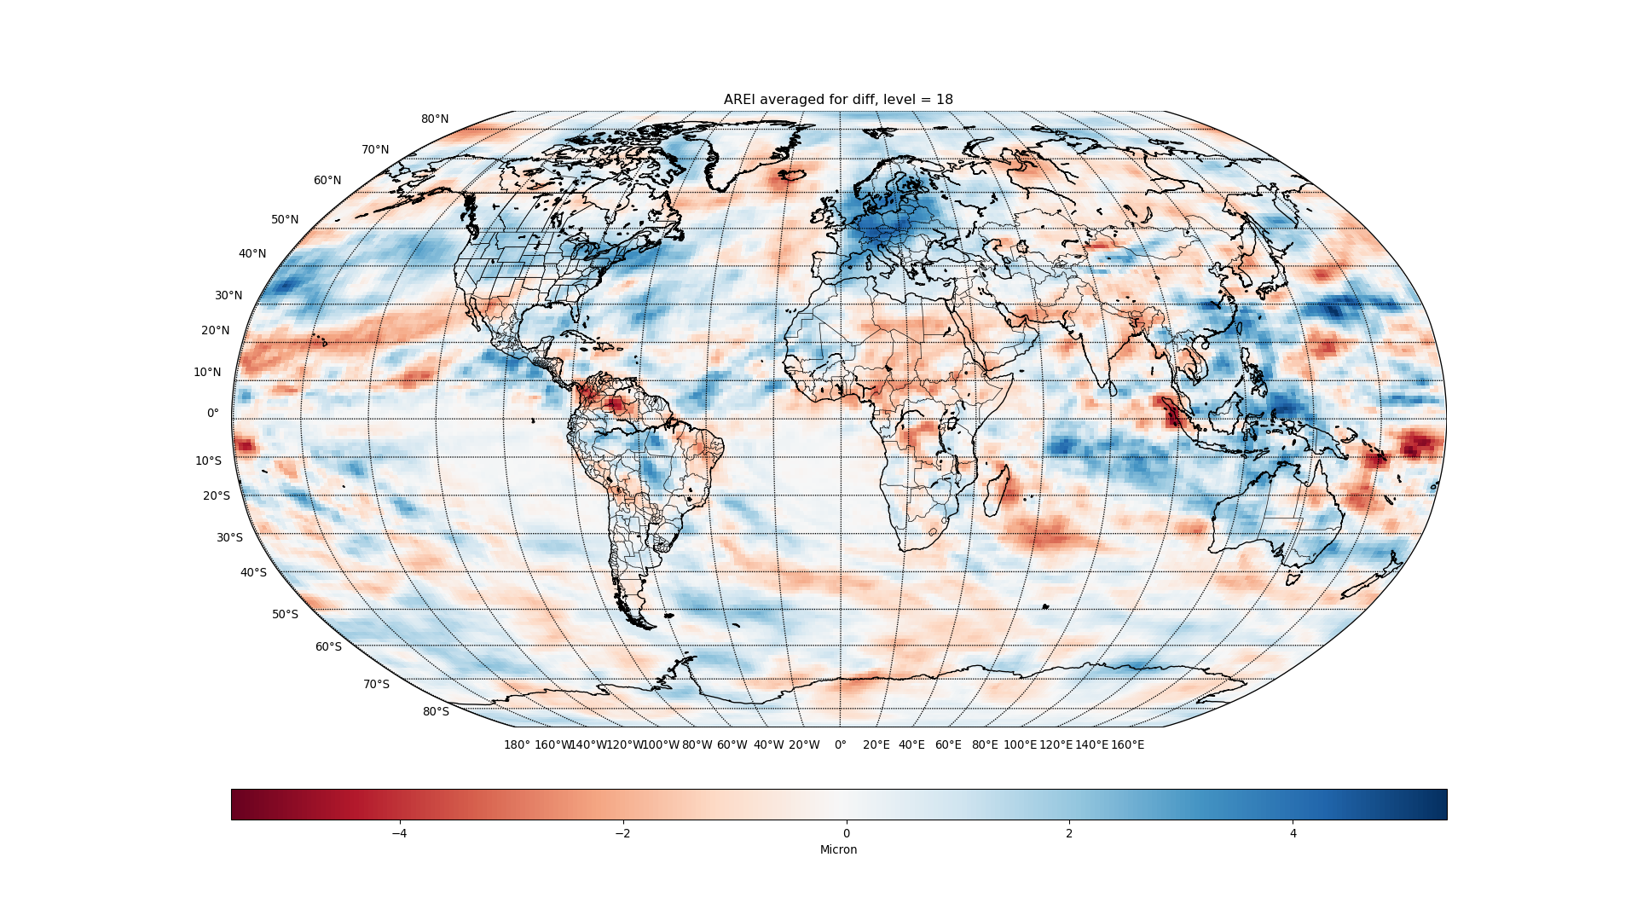

Slide 11
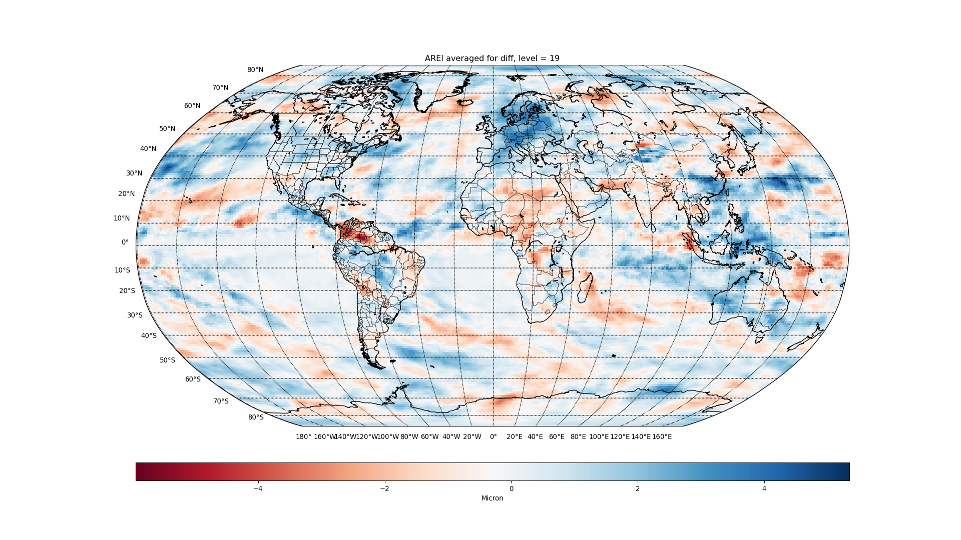

Slide 12
CLDICE

Slide 13
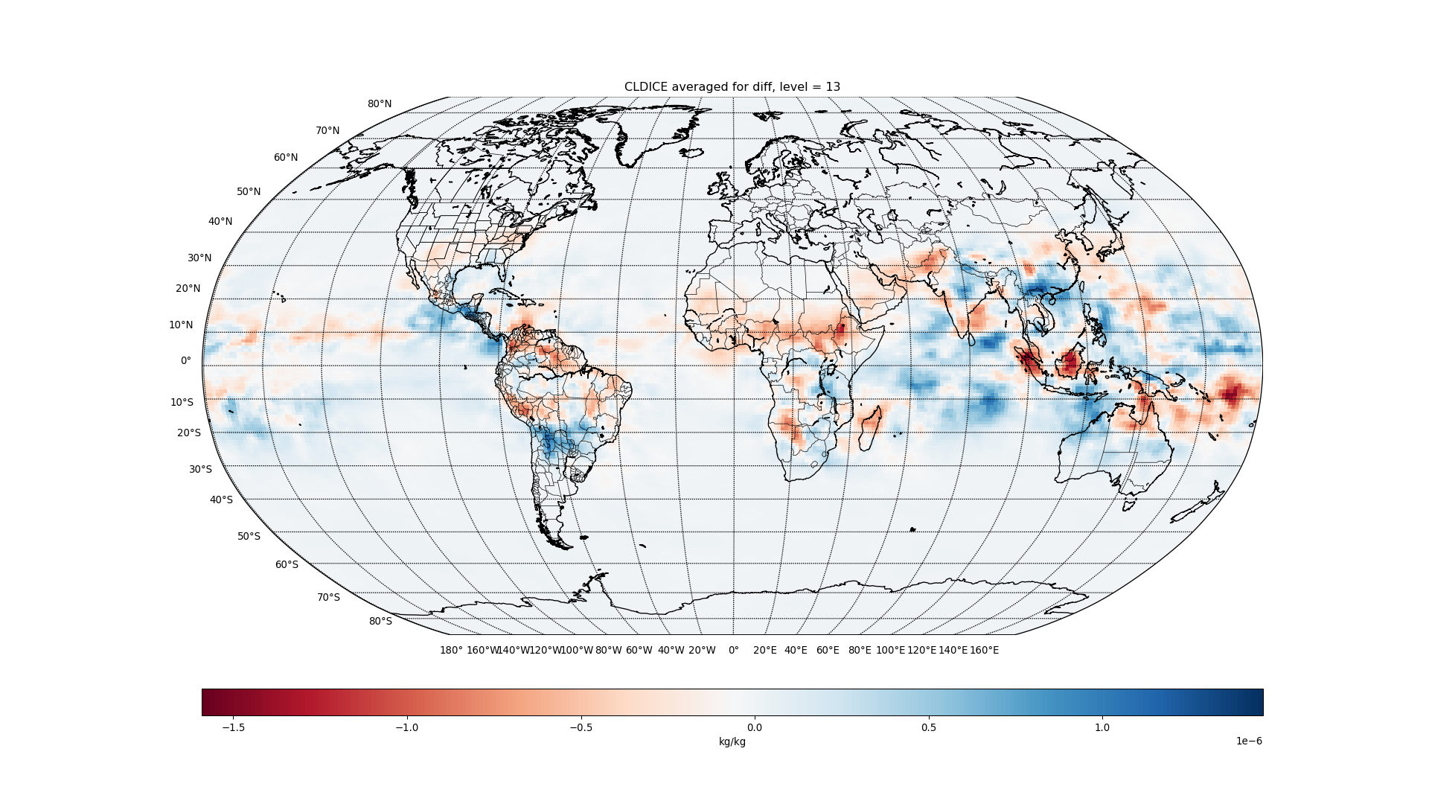

Slide 14
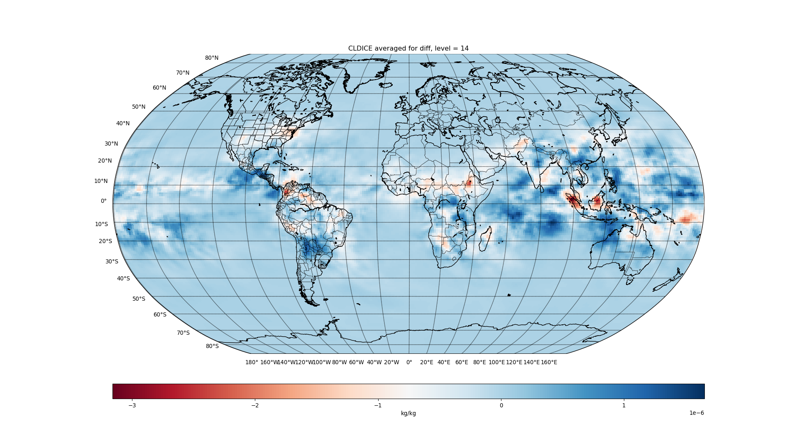

Slide 15
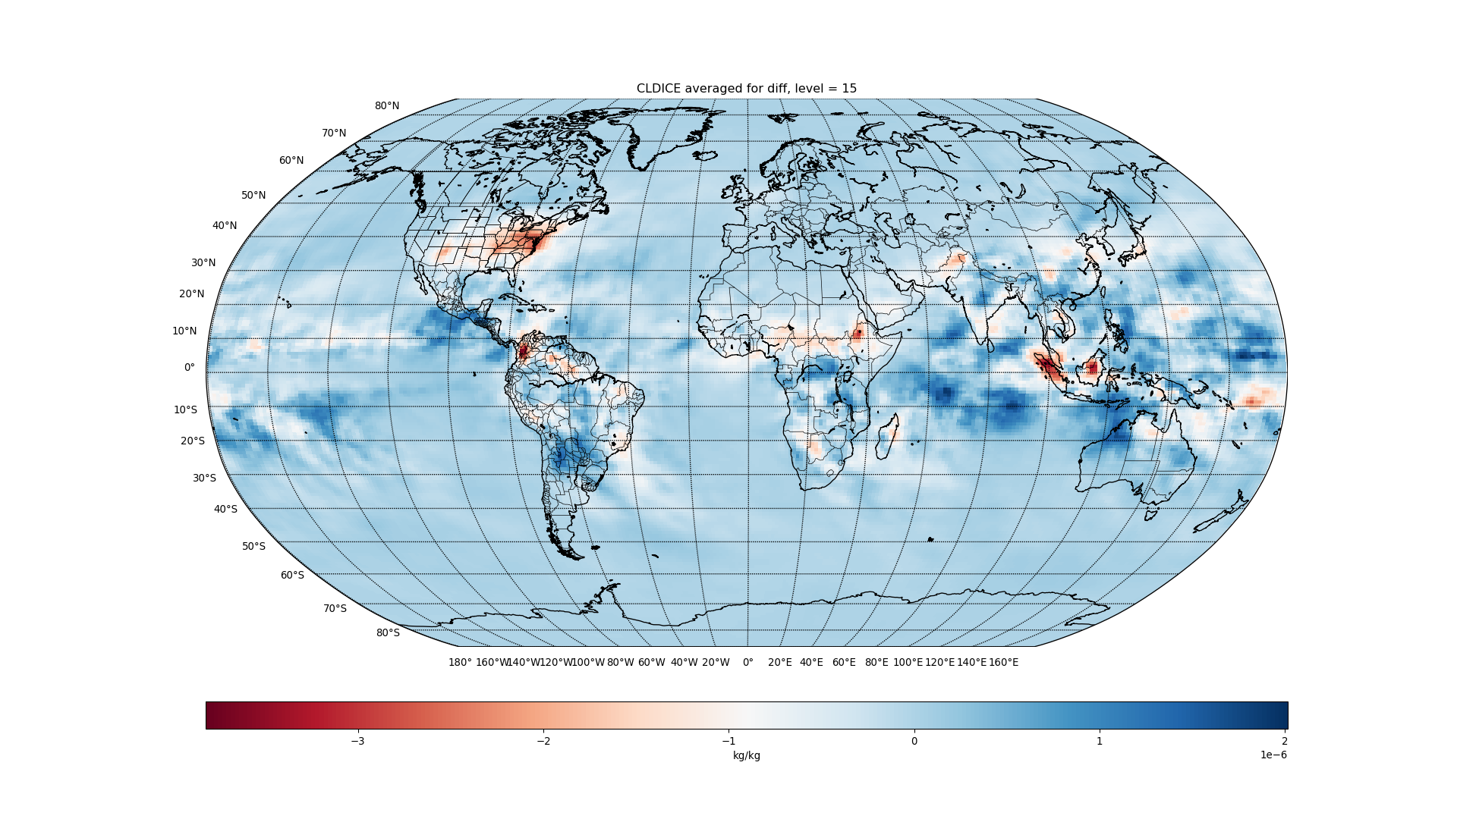

Slide 16
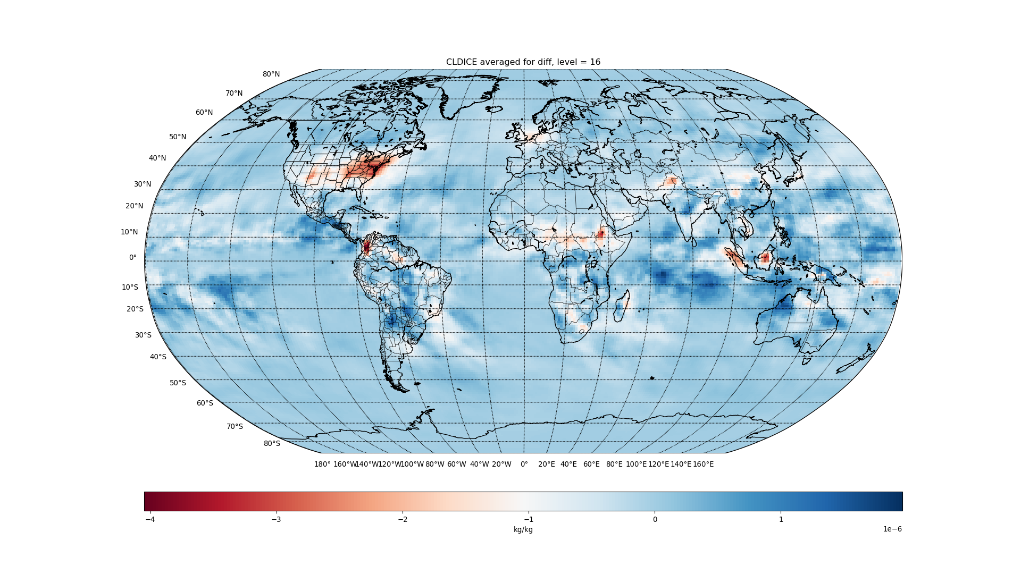

Slide 17
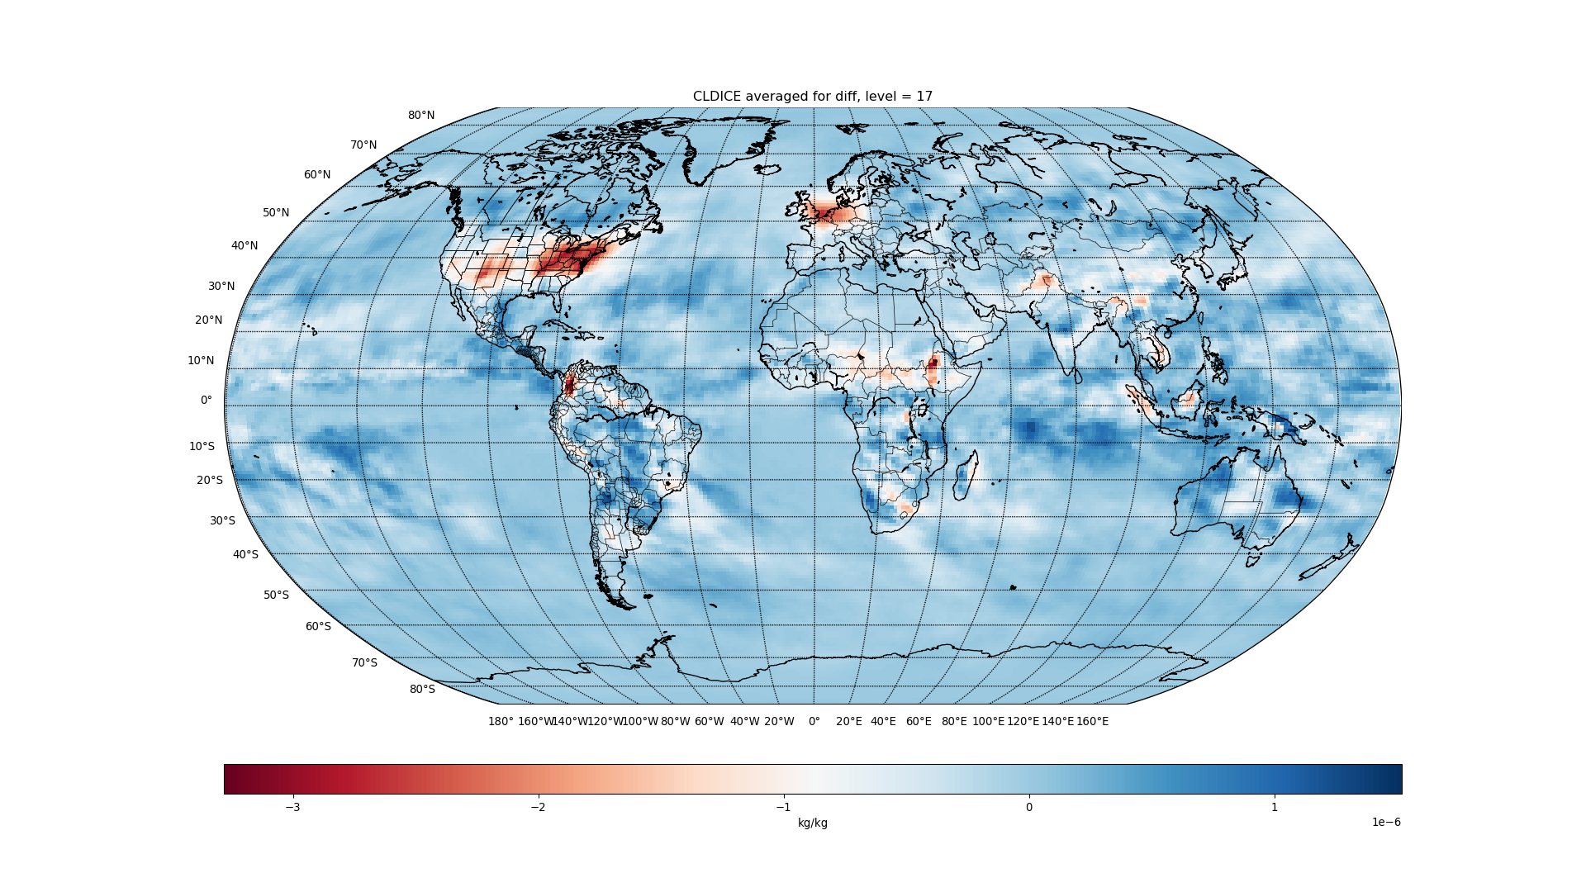

Slide 18
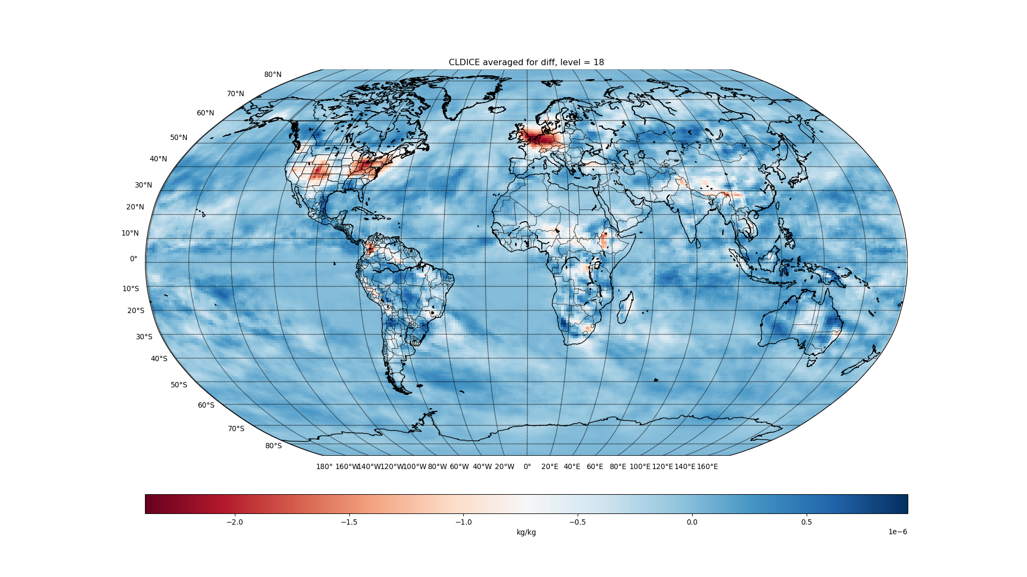

Slide 19
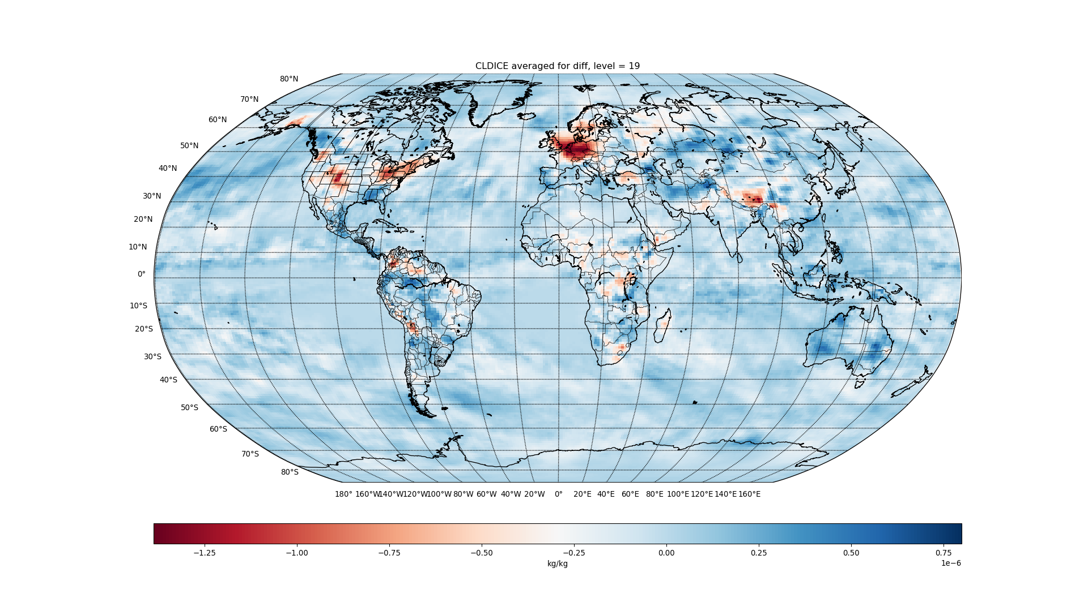

Slide 20
FREQI

Slide 21
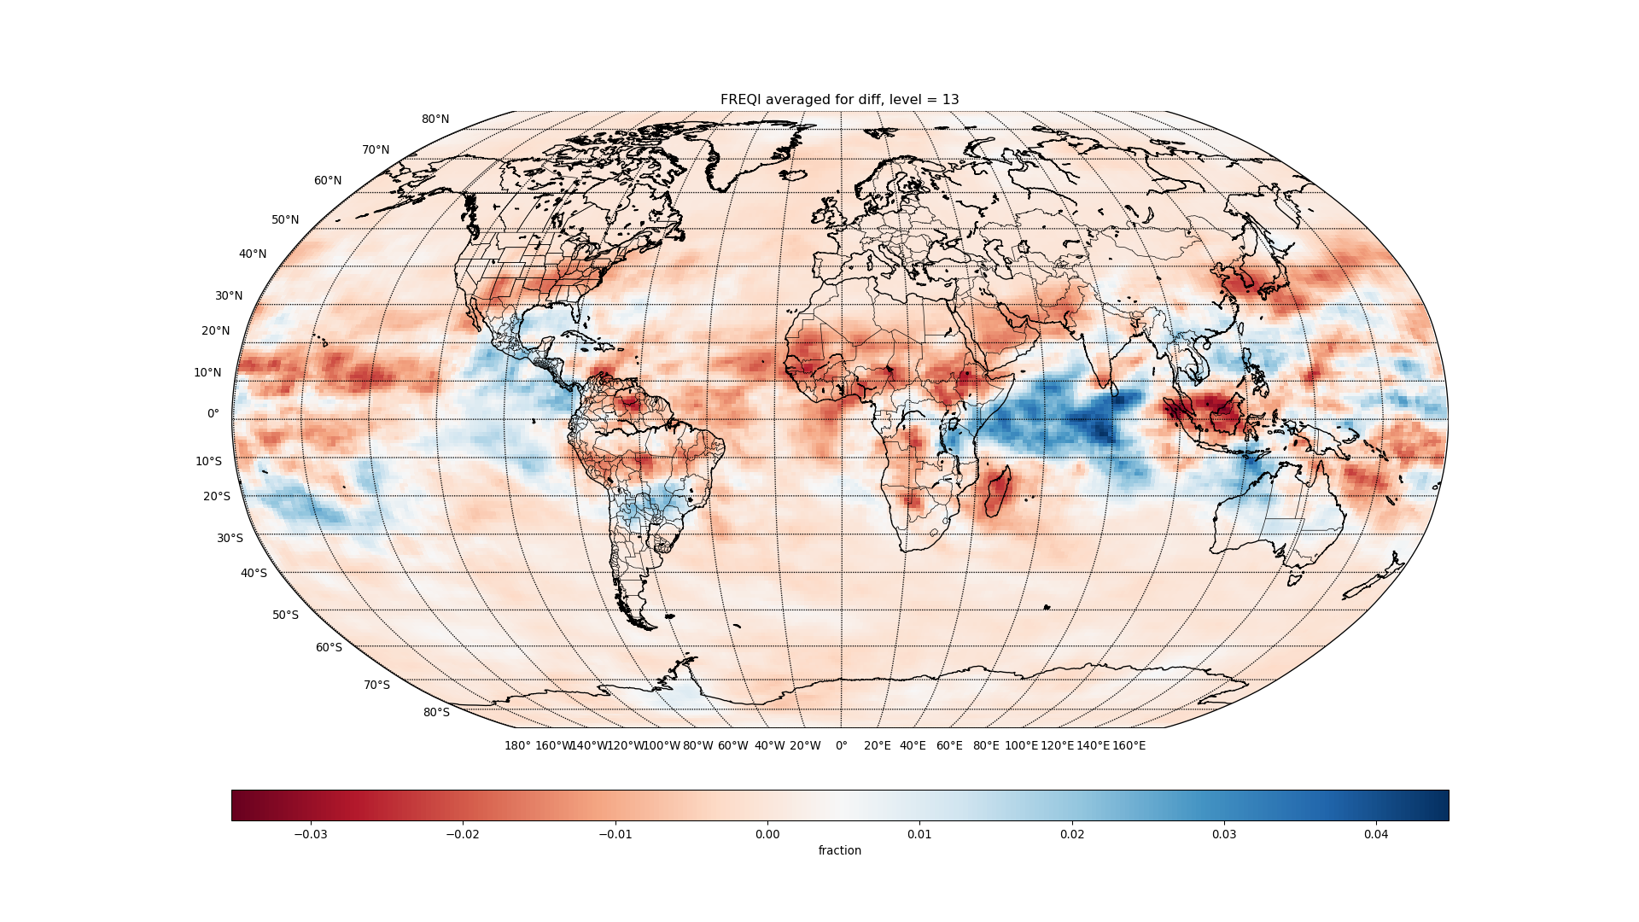

Slide 22
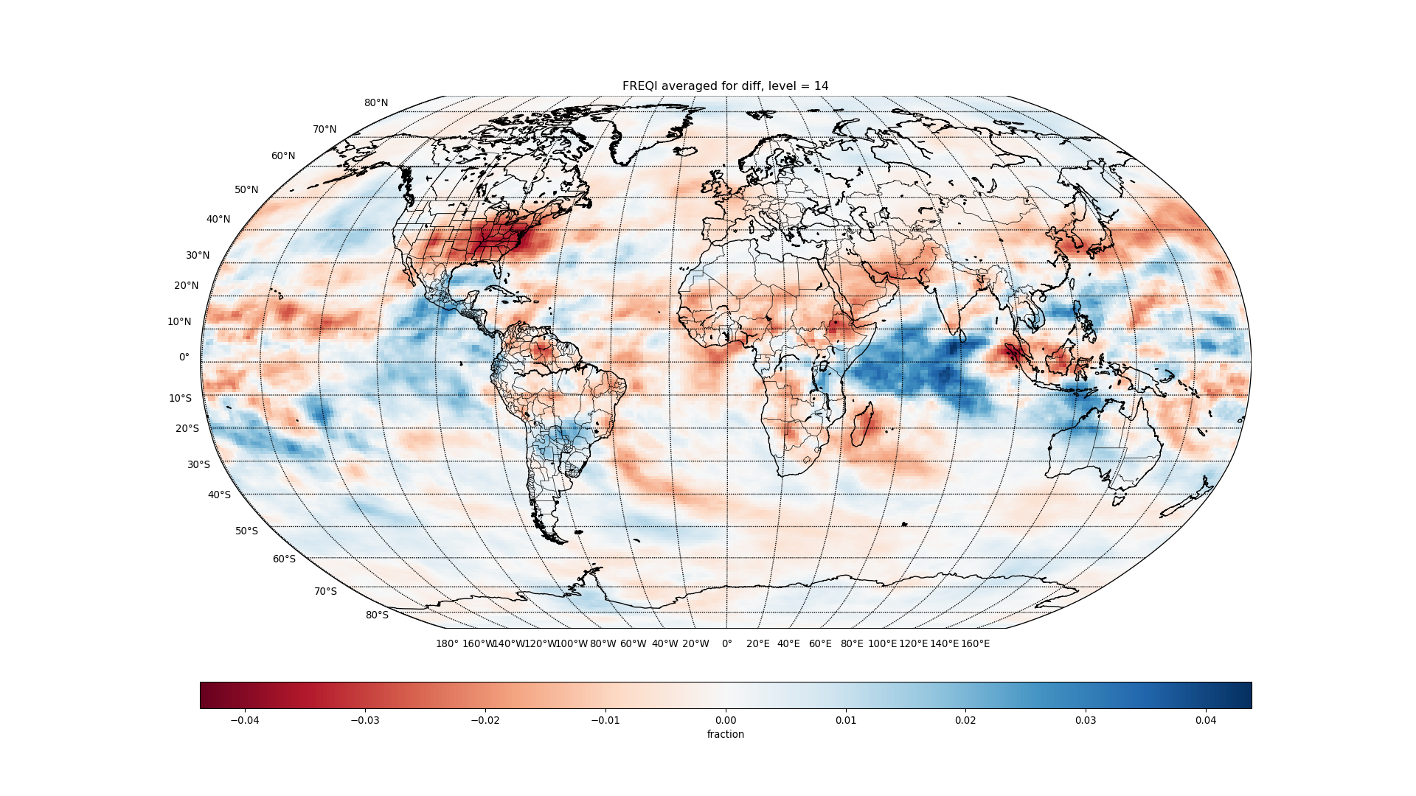

Slide 23
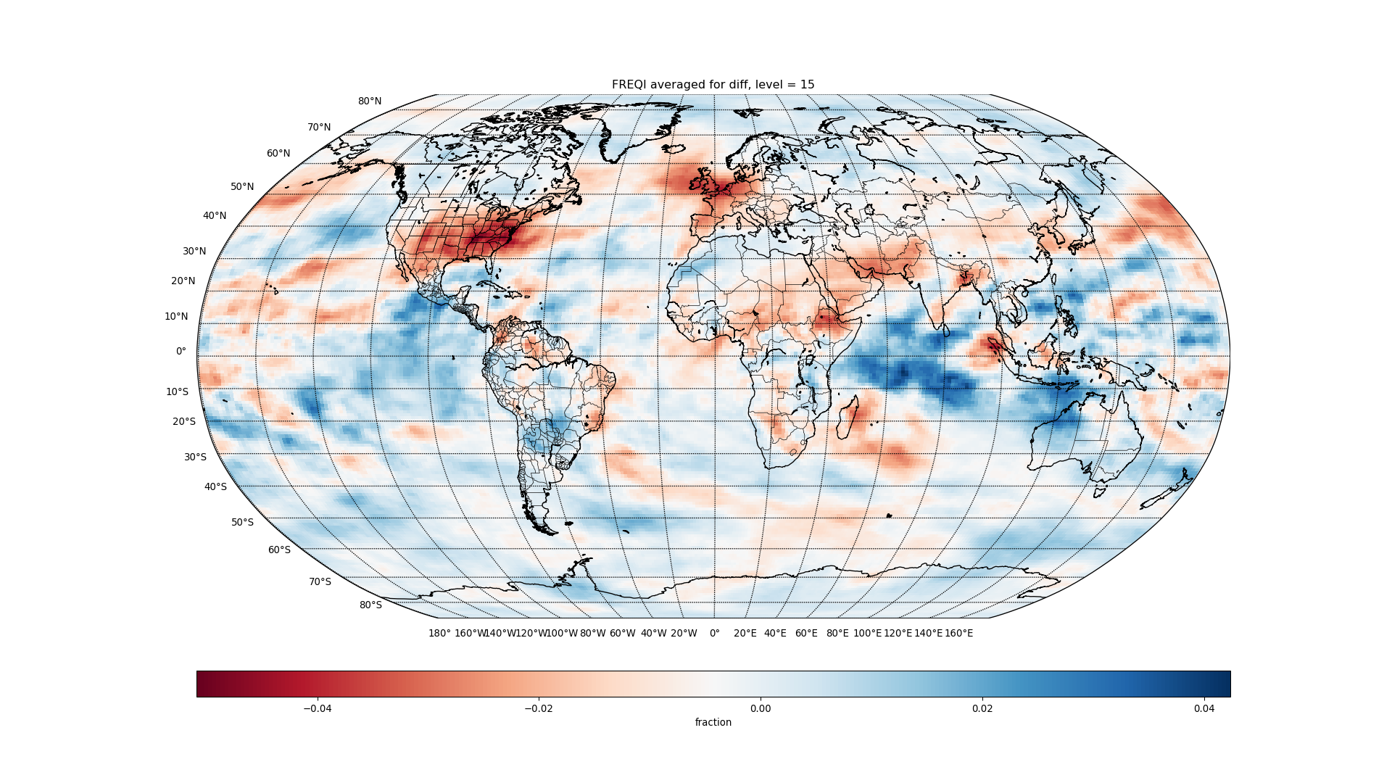

Slide 24
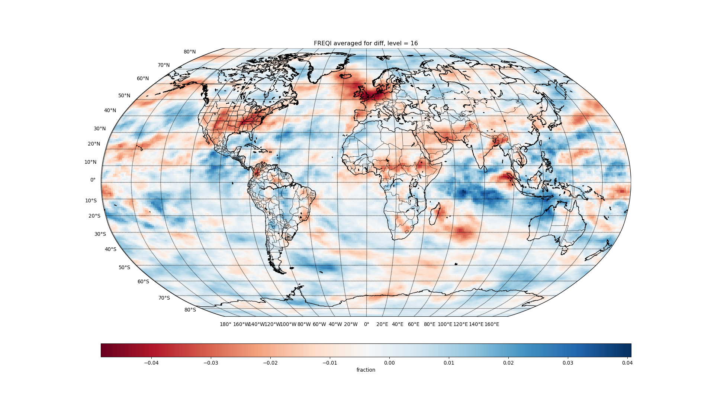

Slide 25
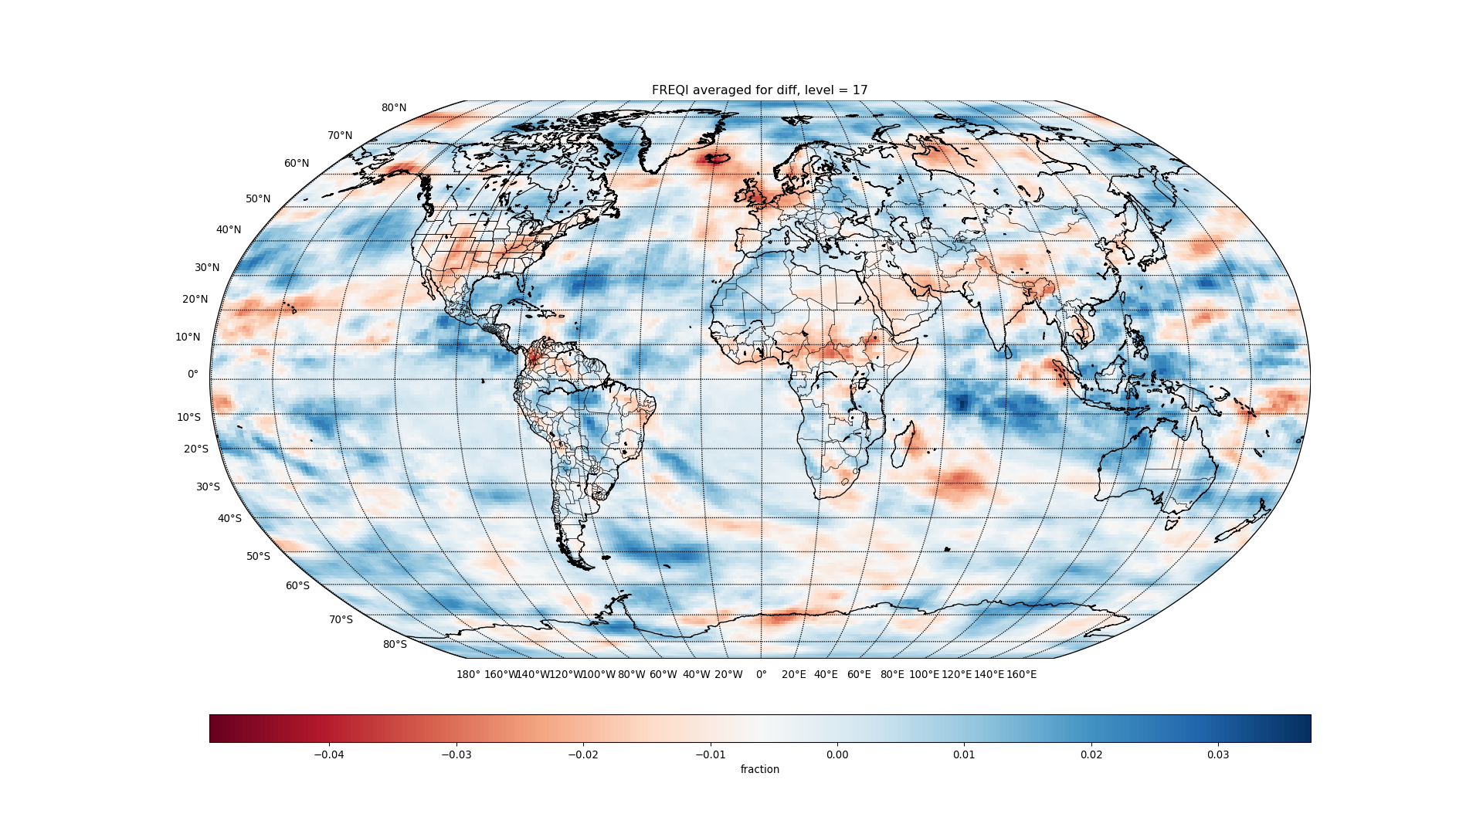

Slide 26
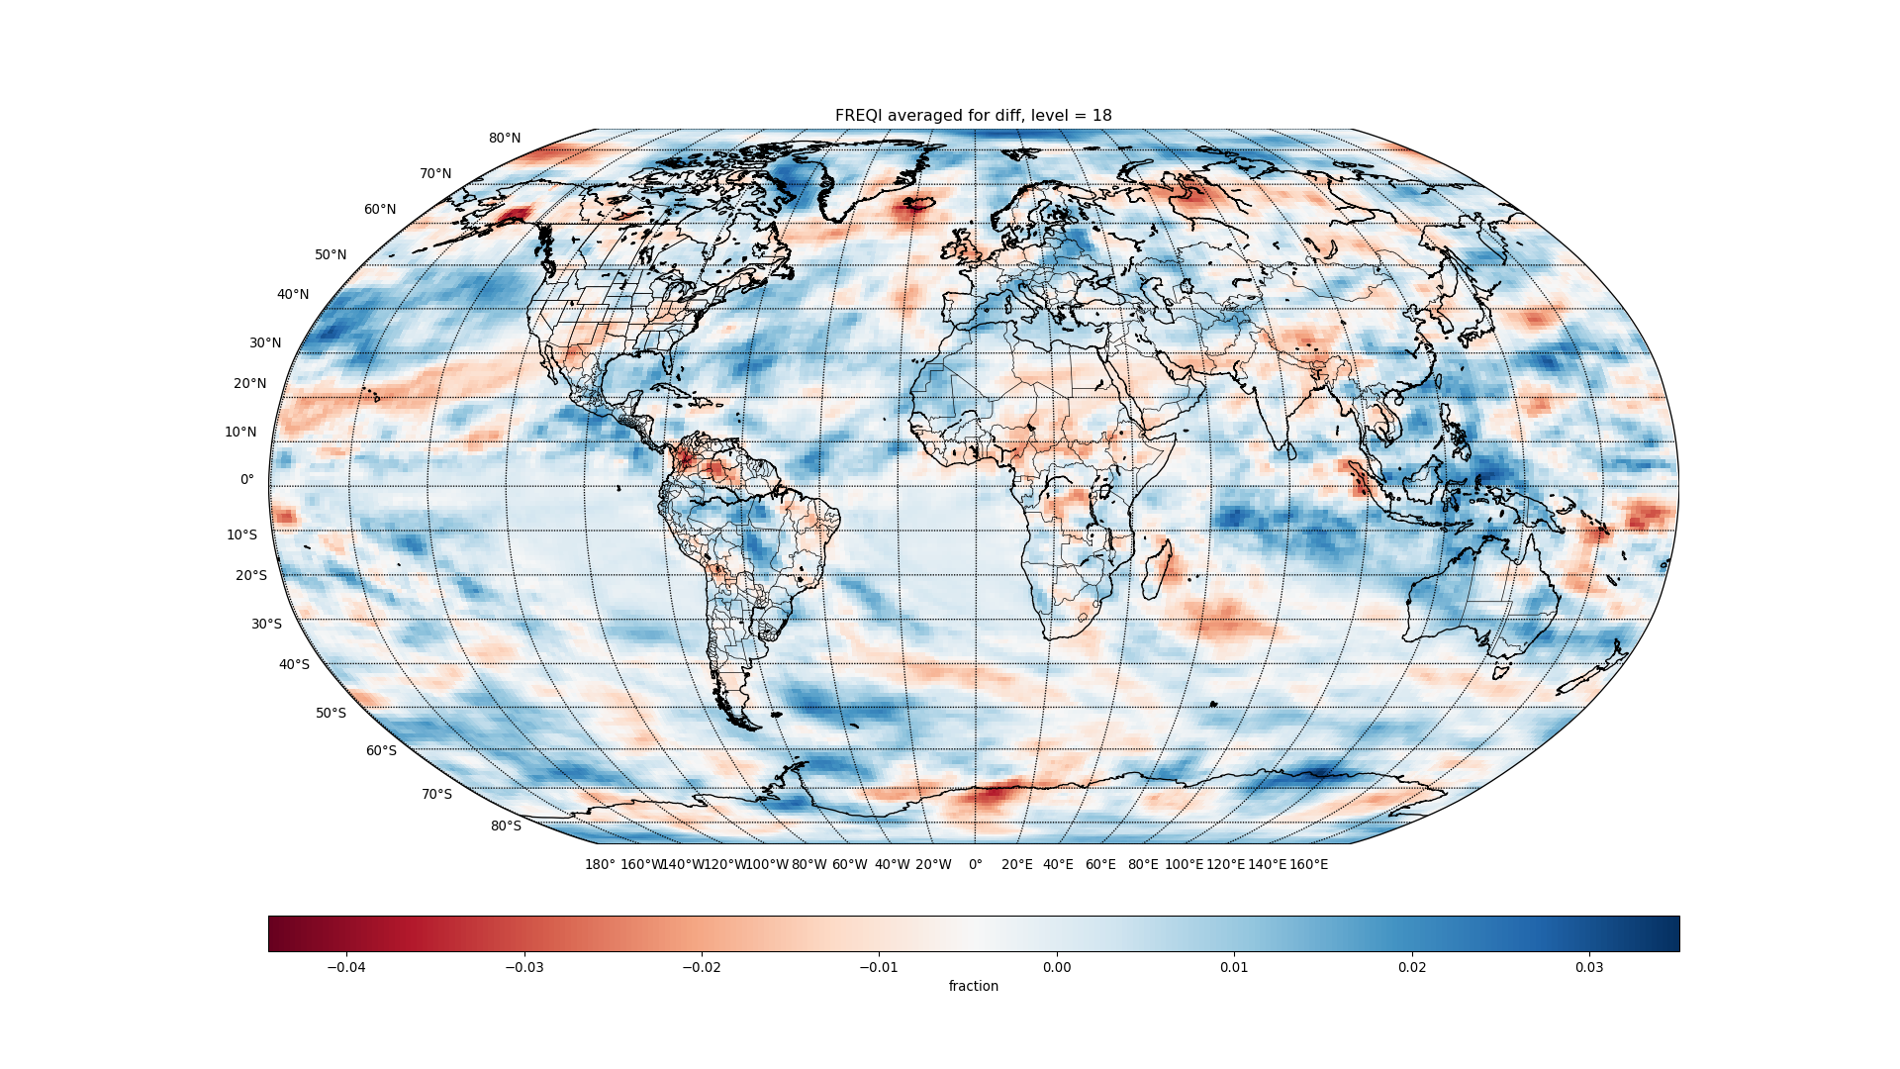

Slide 27
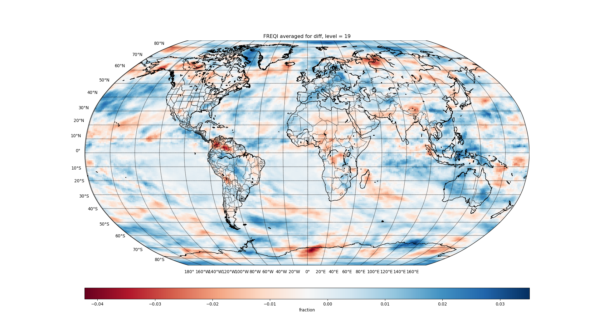

Slide 28
ICIMR

Slide 29
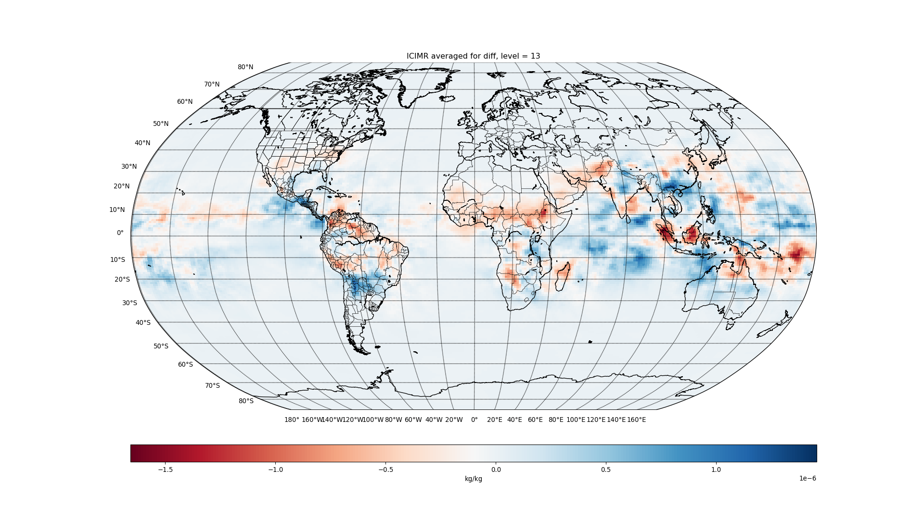

Slide 30
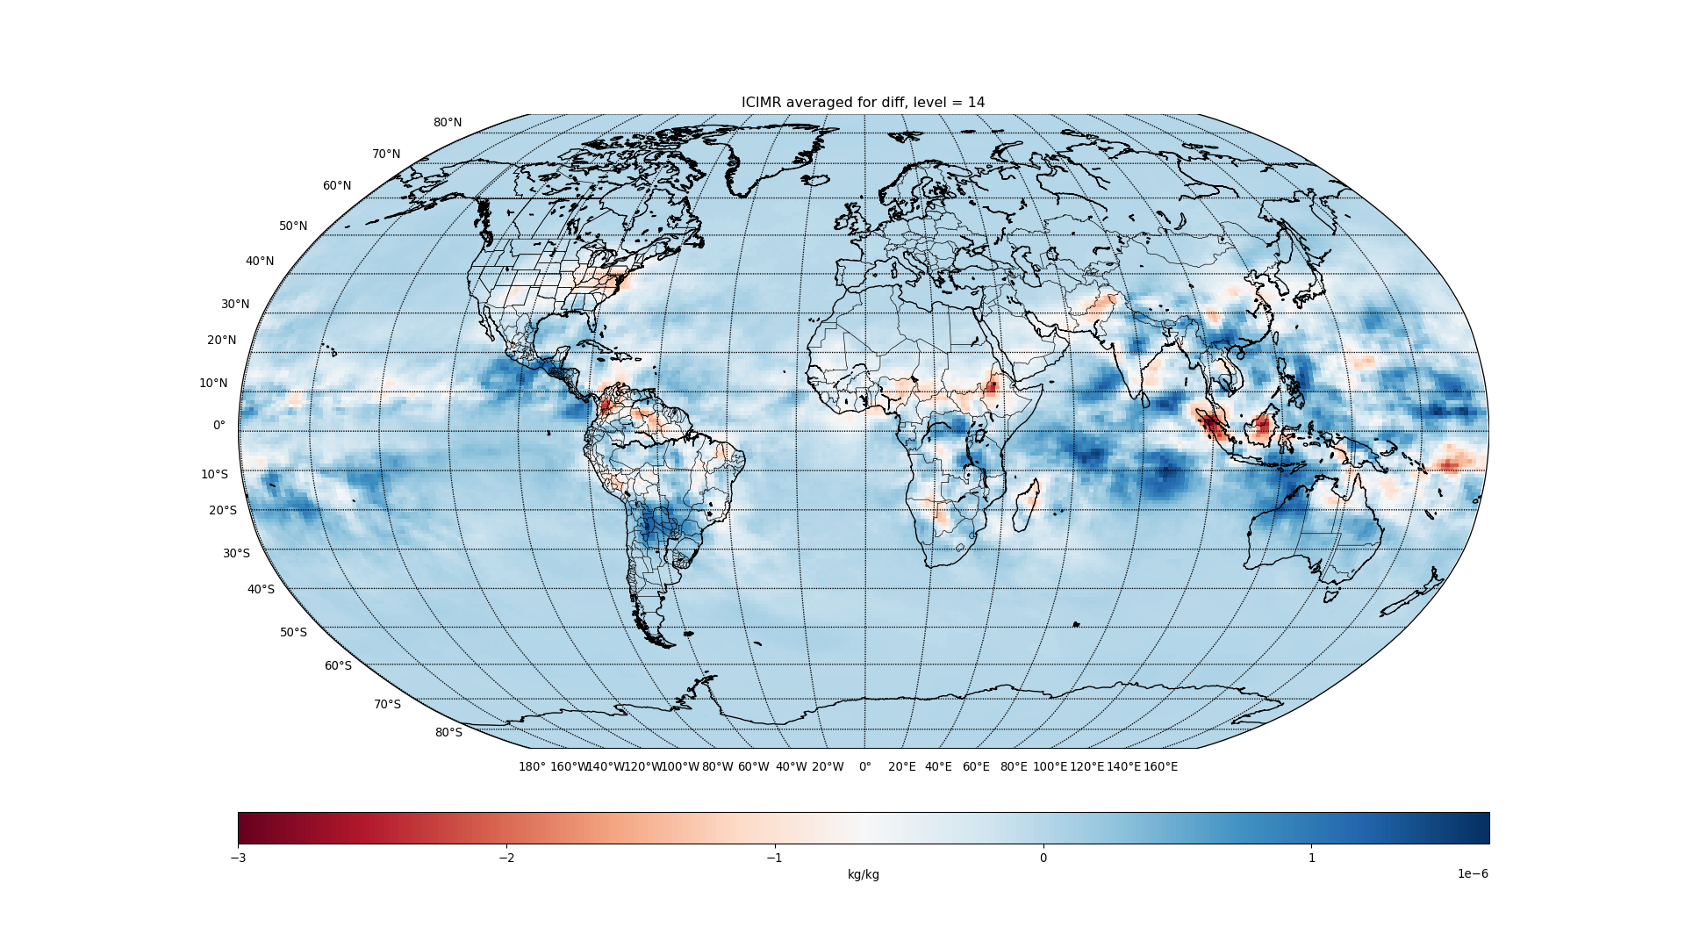

Slide 31
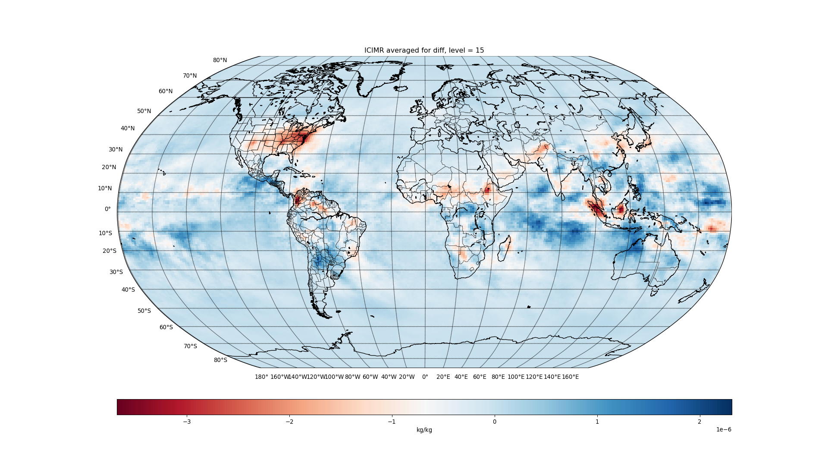

Slide 32
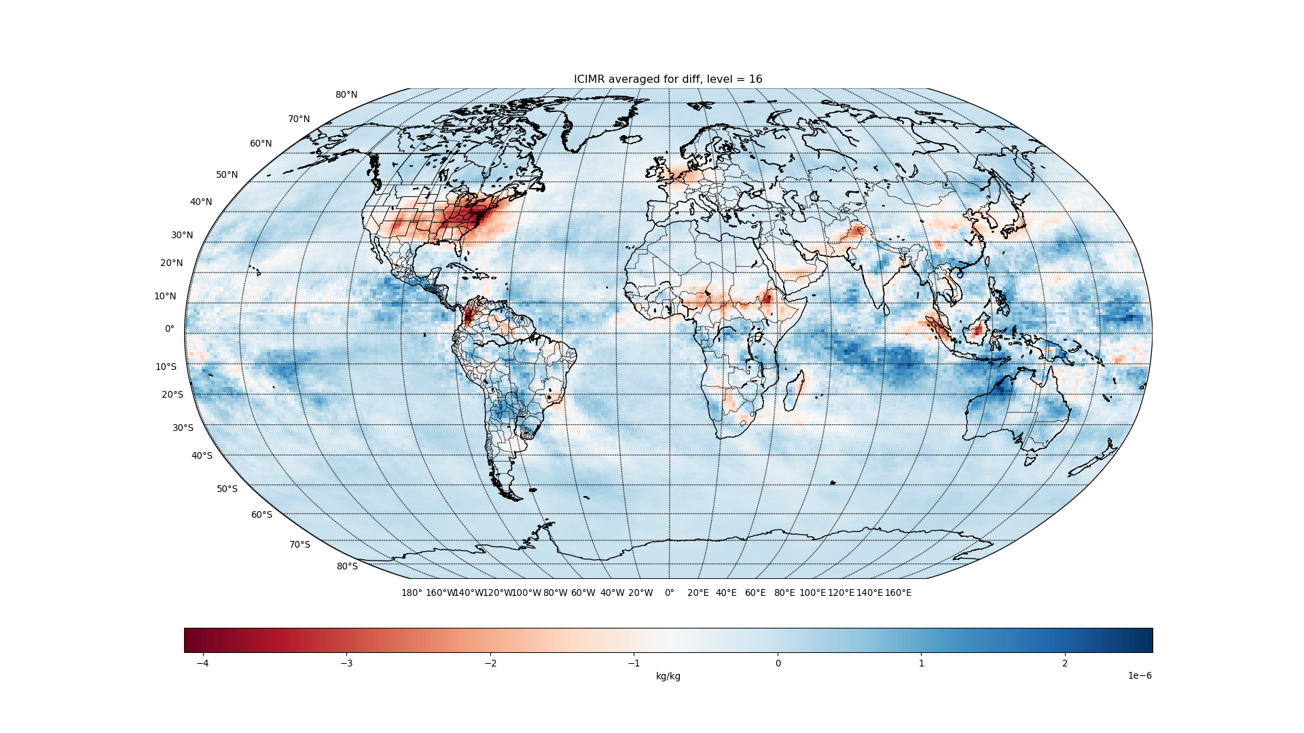

Slide 33
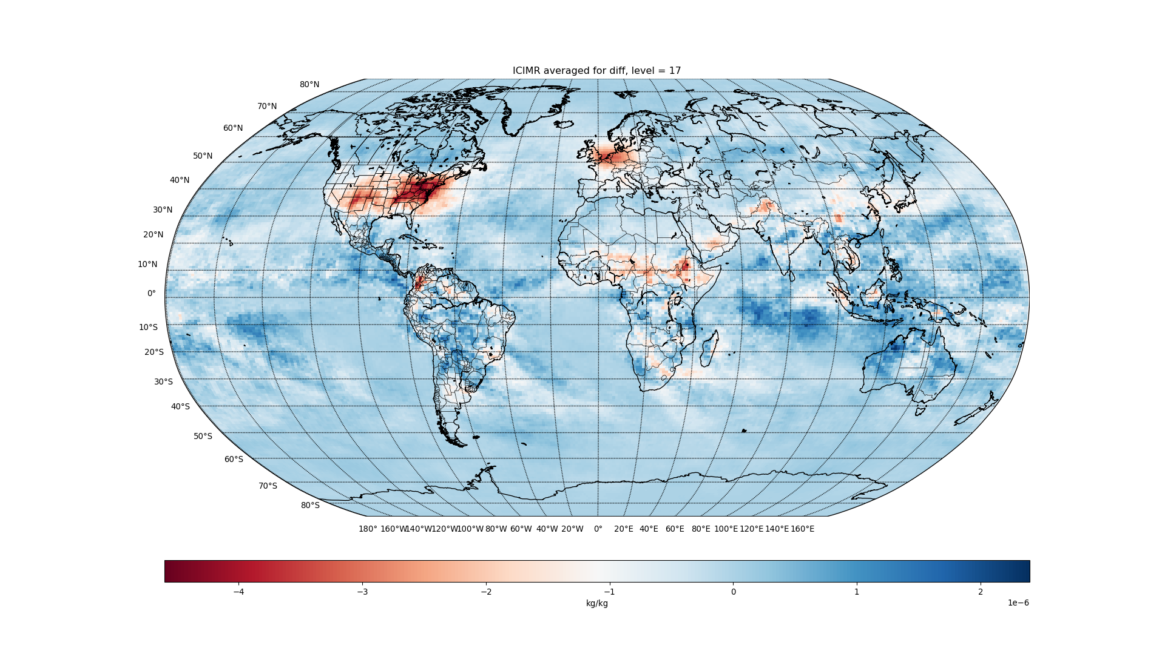

Slide 34
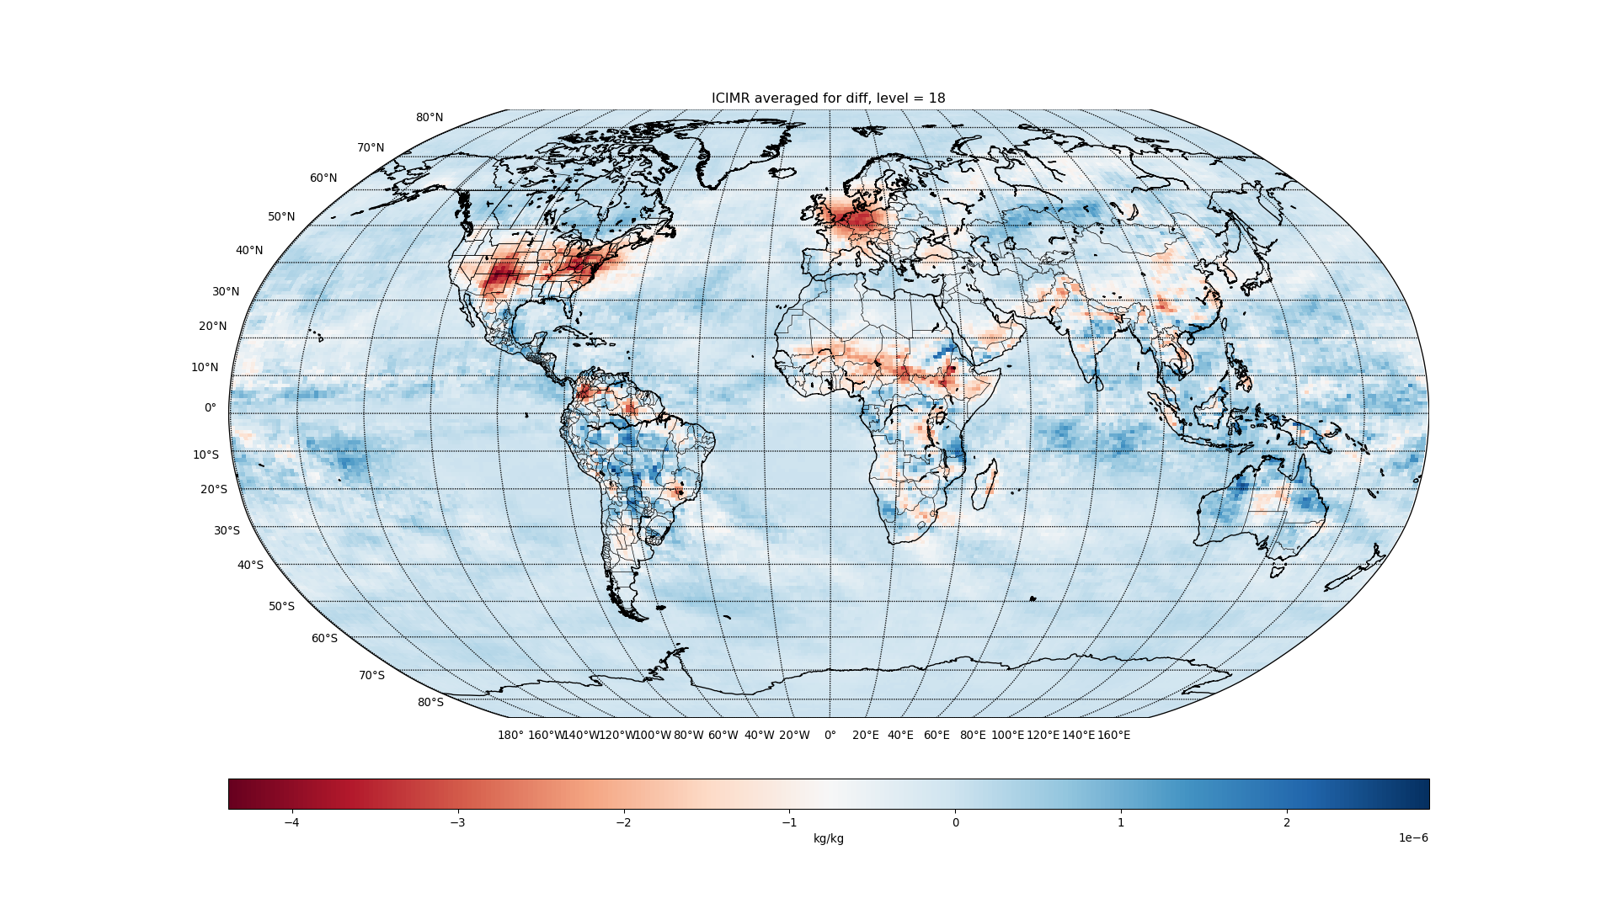

Slide 35
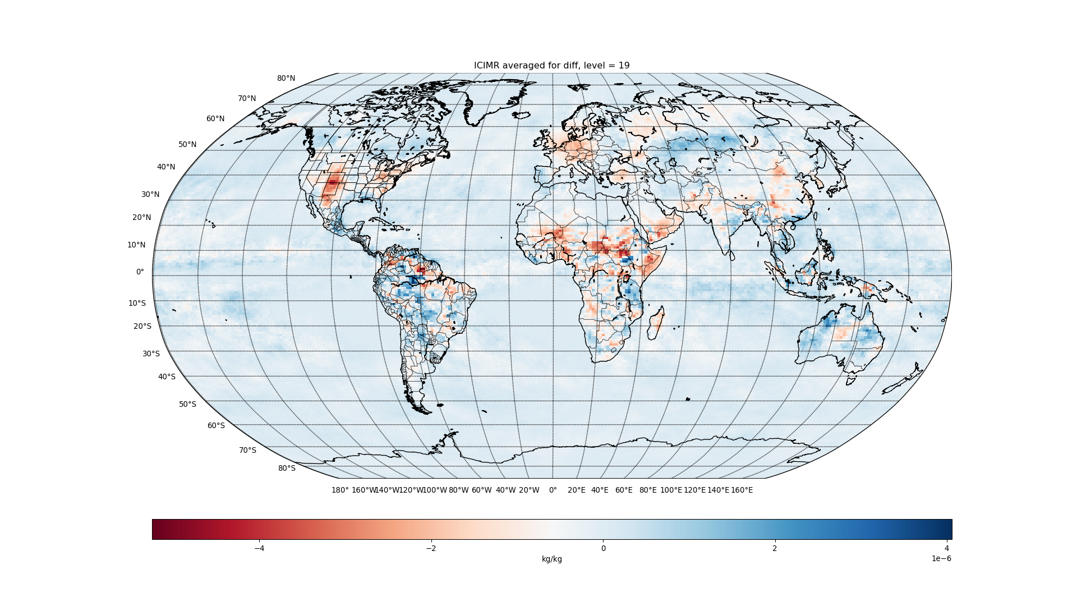

Slide 36
IWC

Slide 37


Slide 38


Slide 39


Slide 40
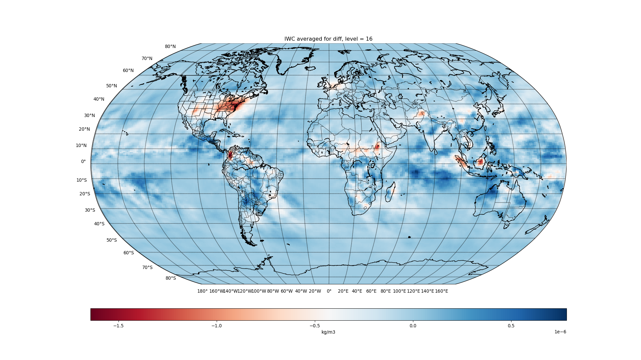

Slide 41
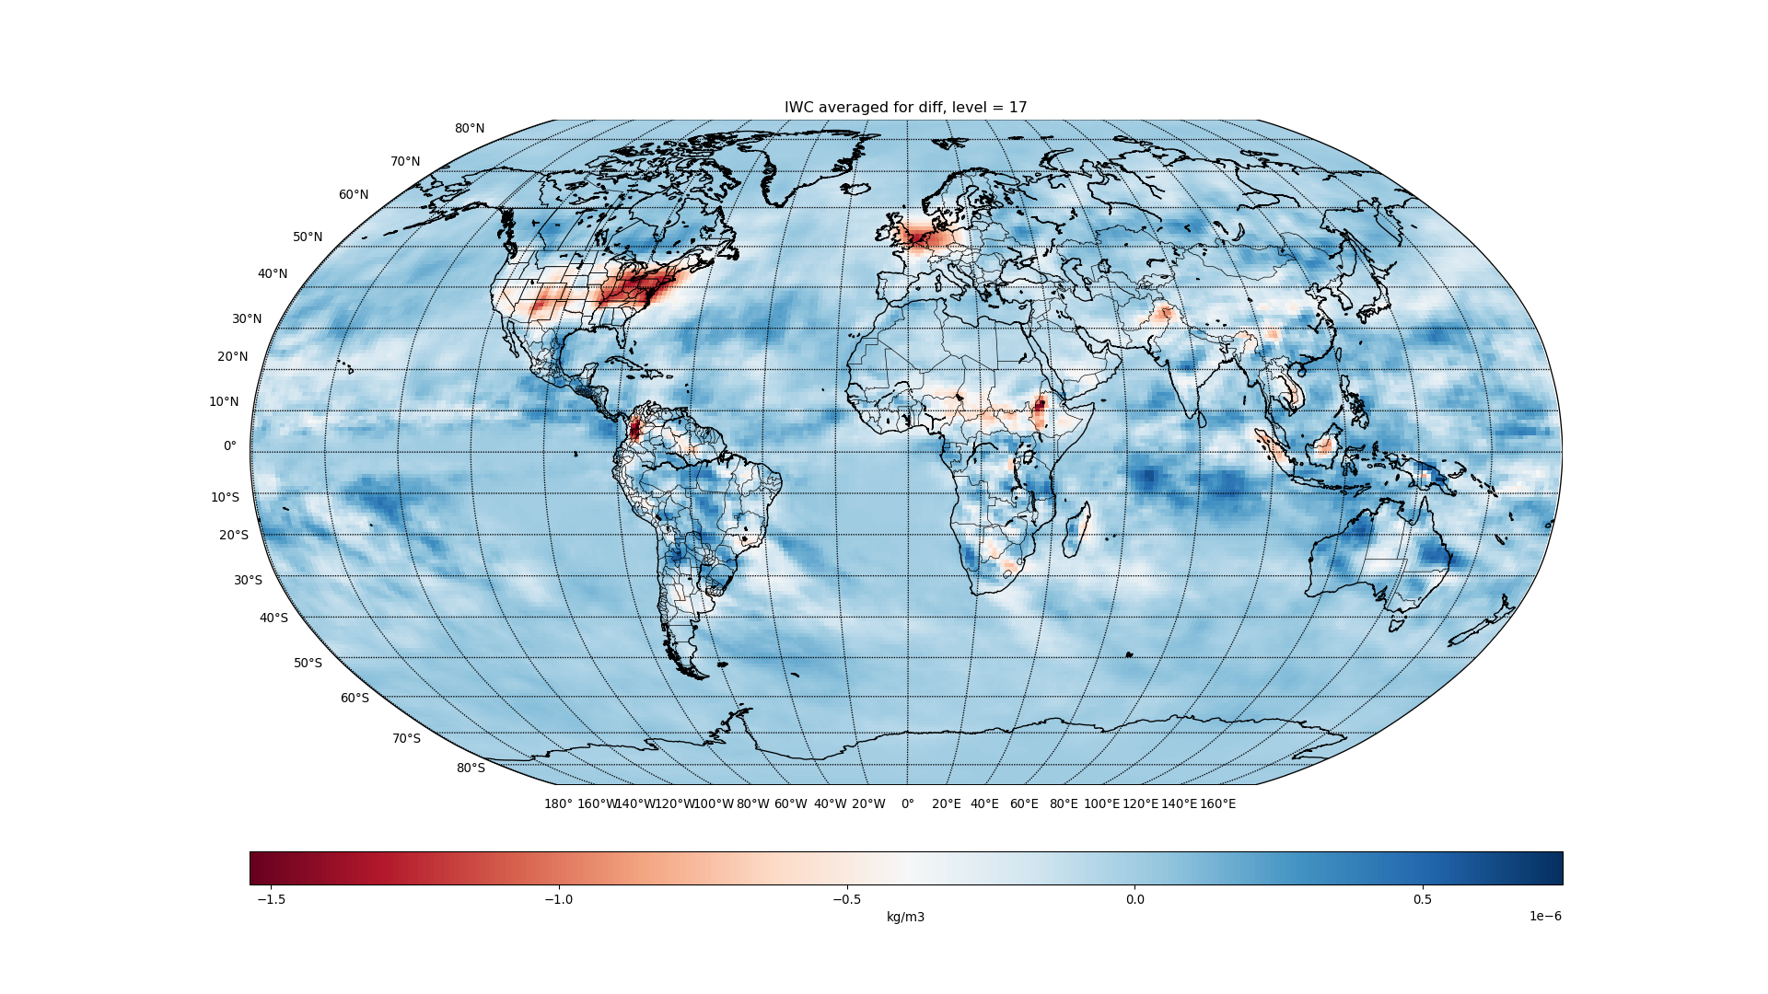

Slide 42


Slide 43
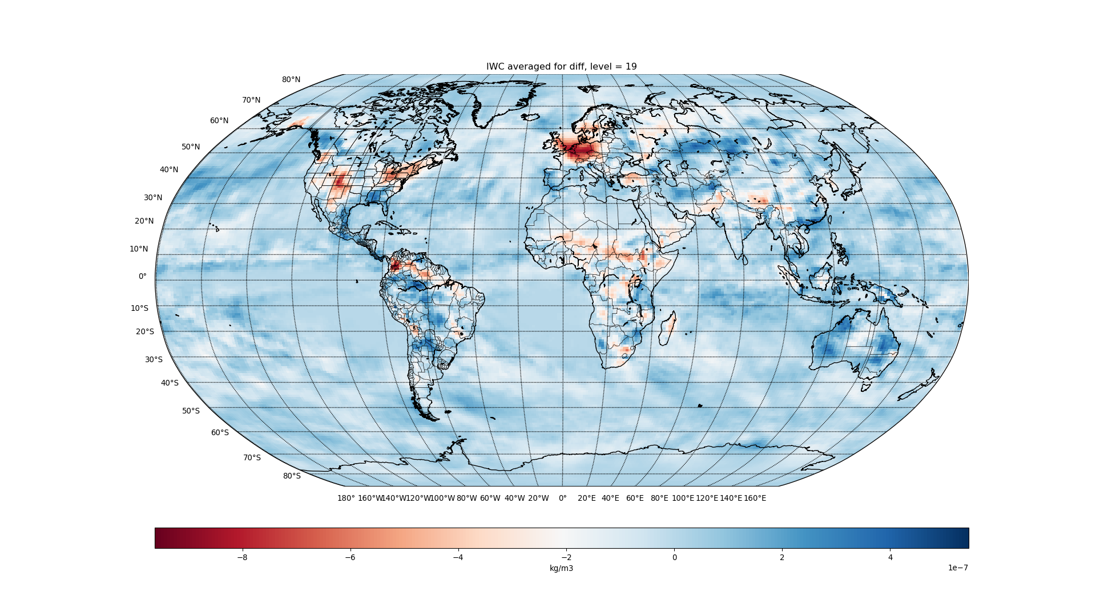

Slide 44
QRL

Slide 45
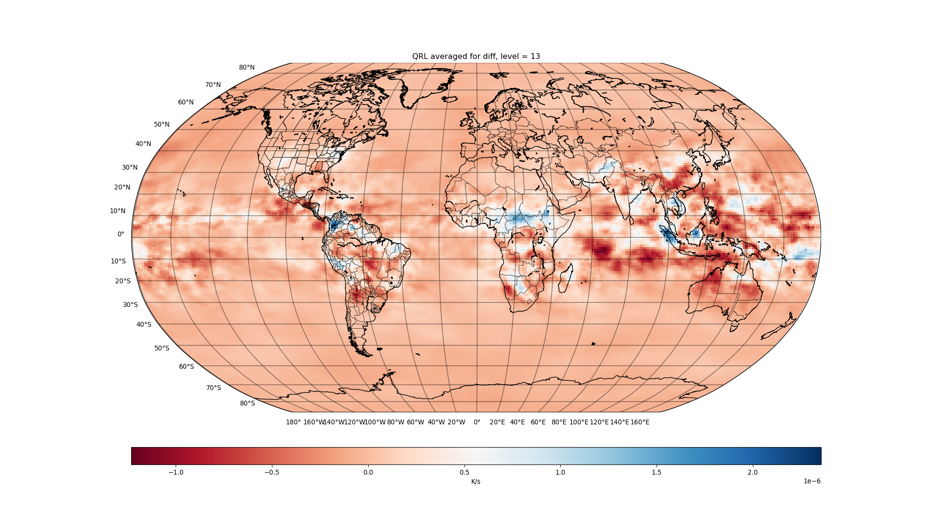

Slide 46
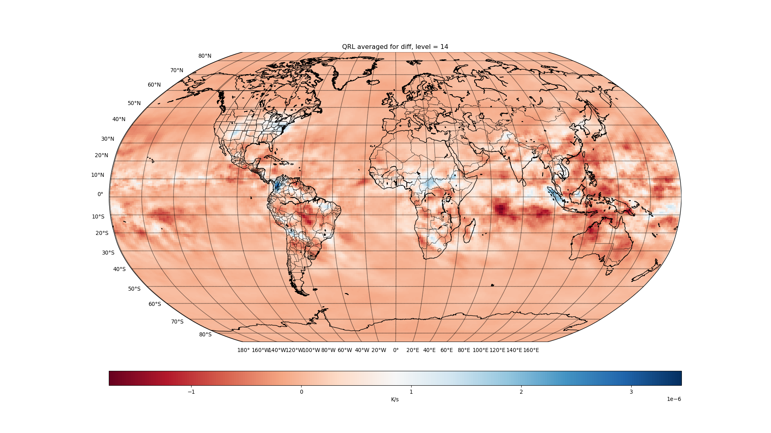

Slide 47
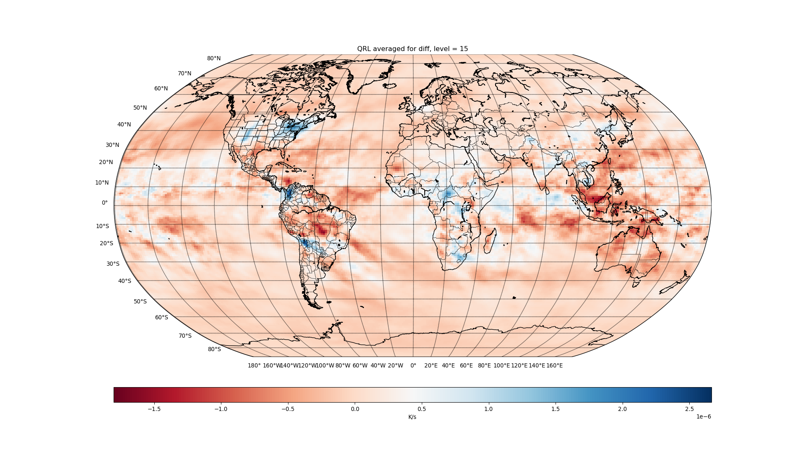

Slide 48
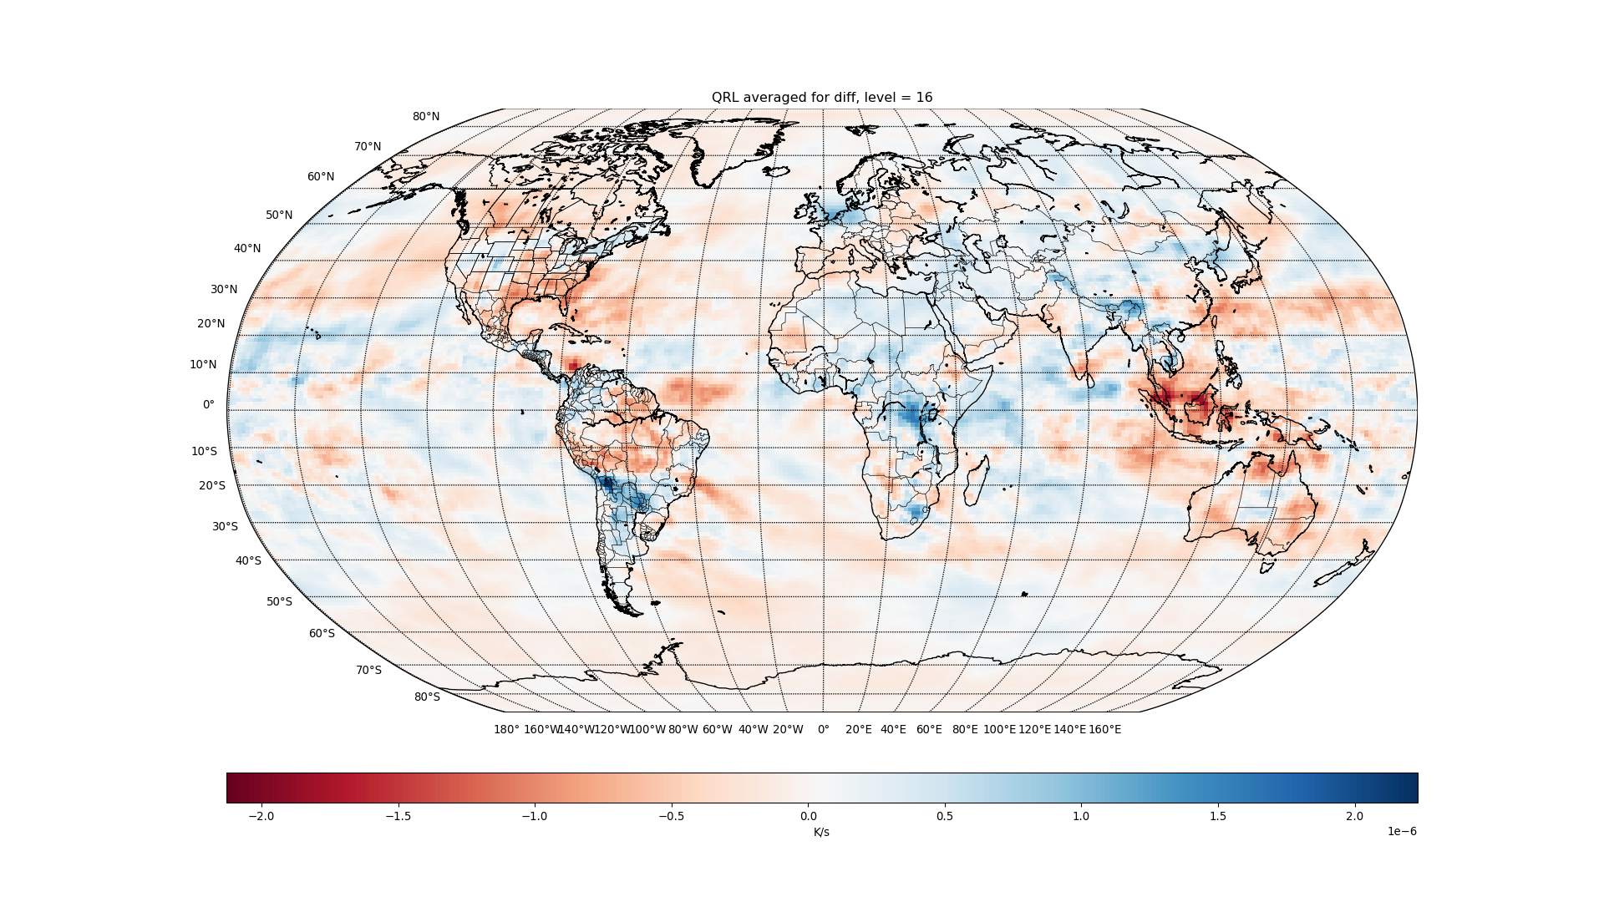

Slide 49
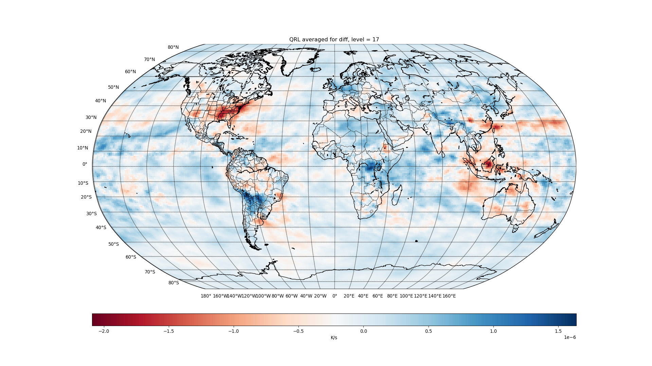

Slide 50
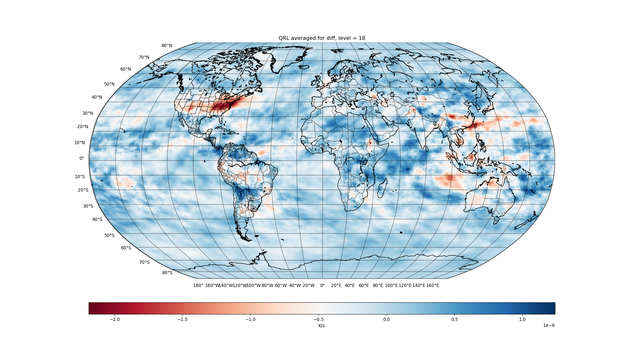

Slide 51
